Slide 1
Decision Trees
a bold adventure

Slide 2
What type of algorithm is this?
We’ll be talking about using decision trees when trying to predict the class a datapoint belongs to. In that context, this algo is
Supervised
Classification
Information-based
Discriminative
We’ll go over at the end!

Slide 3
Broadly - decision trees
Chasten is deciding whether to go to a party, but will only go if Miley goes. So he seeks more information about the party.

Slide 4
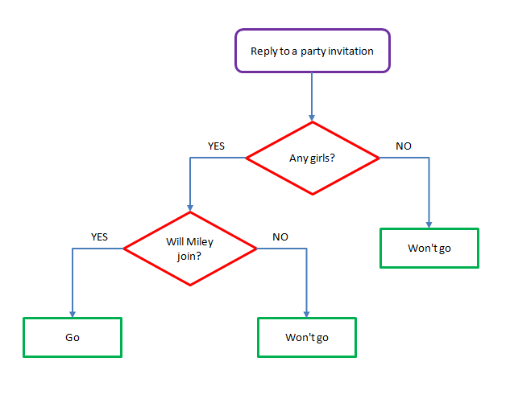
Broadly - decision trees
Chasten is deciding whether to go to a party, but will only go if Miley goes. So he seeks more information about the party.

Slide 5
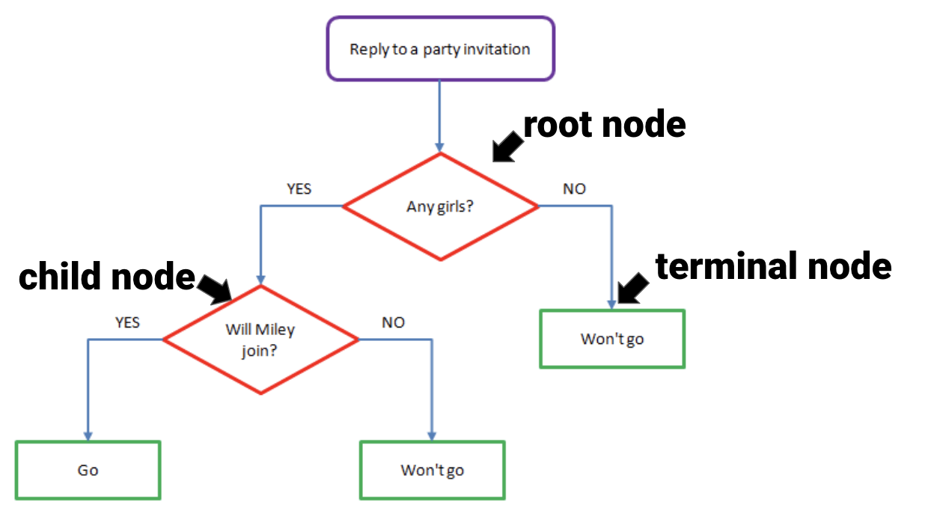
Broadly - decision trees
aka “leaf”

Slide 6
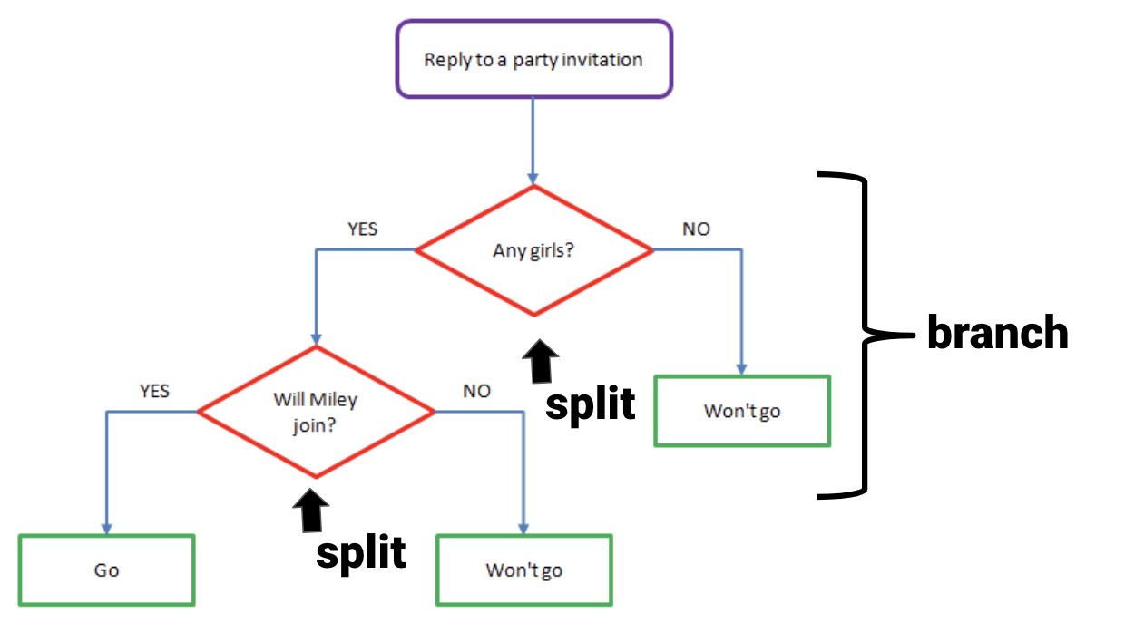
Broadly - decision trees

Slide 7
Broadly - What is the algo doing?
X₂
X₁

Slide 8
Broadly - What is the algo doing?
X₂
X₁

Slide 9
Broadly - What is the algo doing?
X₂
X₁

Slide 10
Broadly - What is the algo doing?
X₂
X₁

Slide 11
Broadly - What is the algo doing?
X₂
X₁

Slide 12
Broadly - What is the algo doing?
X₂
X₁

Slide 13
Broadly - What is the algo doing?
X₂
X₁

Slide 14
Broadly - What is the algo doing?
Find the specific value in one variable that maximizes the efficiency in splitting data among classes
Split the data at that value in that one variable. This becomes a “node” in the decision tree. The data is split at this node into different branches.
For each branch of the data, repeat the above steps: find the specific value in one variable that maxes classification efficiency to create a new node, and split the data into further branches at that value
STOP SPLITTING when? Options, but can go until each “bucket” only has one class (in which case, they are “pure”)

Slide 15
Broadly - What is the algo doing?
“Iterative Dichotomizer 3”, or “ID3”
Find the specific value in one variable that maximizes the efficiency in splitting data among classes
Split the data at that value in that one variable. This becomes a “node” in the decision tree. The data is split at this node into different branches.
For each branch of the data, repeat the above steps: find the specific value in one variable that maxes classification efficiency to create a new child node, and split the data into further branches at that value
STOP SPLITTING when? Options, but can go until each child node only has one class (in which case, they are “pure”)

Slide 16
Broadly - What is the algo doing?
Once the decision tree has been made (IOW, once the model has been fitted on training data):
new data fed into the model will be routed down the branches in the tree that the training data has made
each test observation will end up in a terminal node (a “leaf”)
and be assigned the class from the training data in that leaf
To be explicit: does the tree change based on new data? No. It has to be re-fit on new data to change.
“greedy”

Slide 17
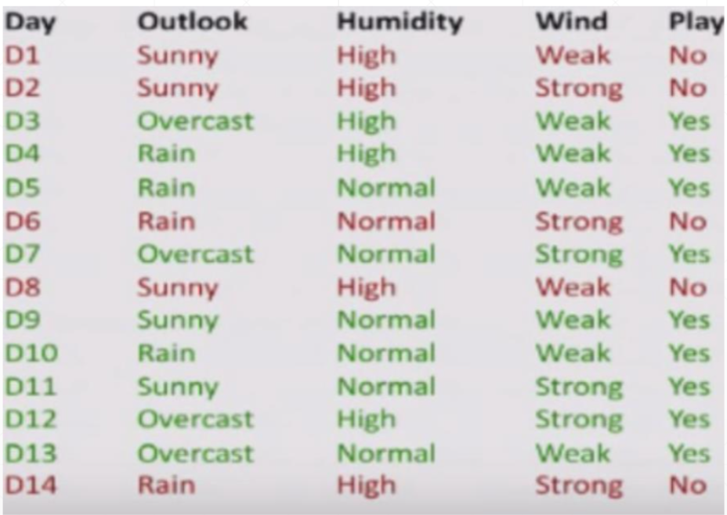

Slide 18
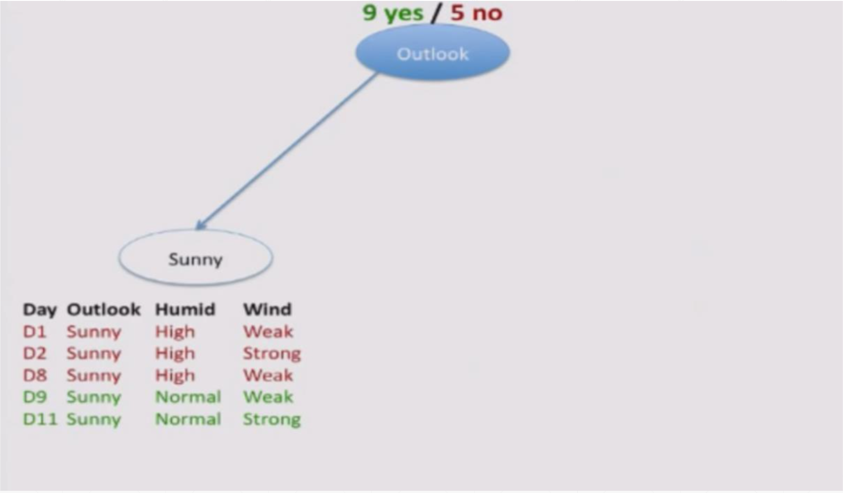

Slide 19
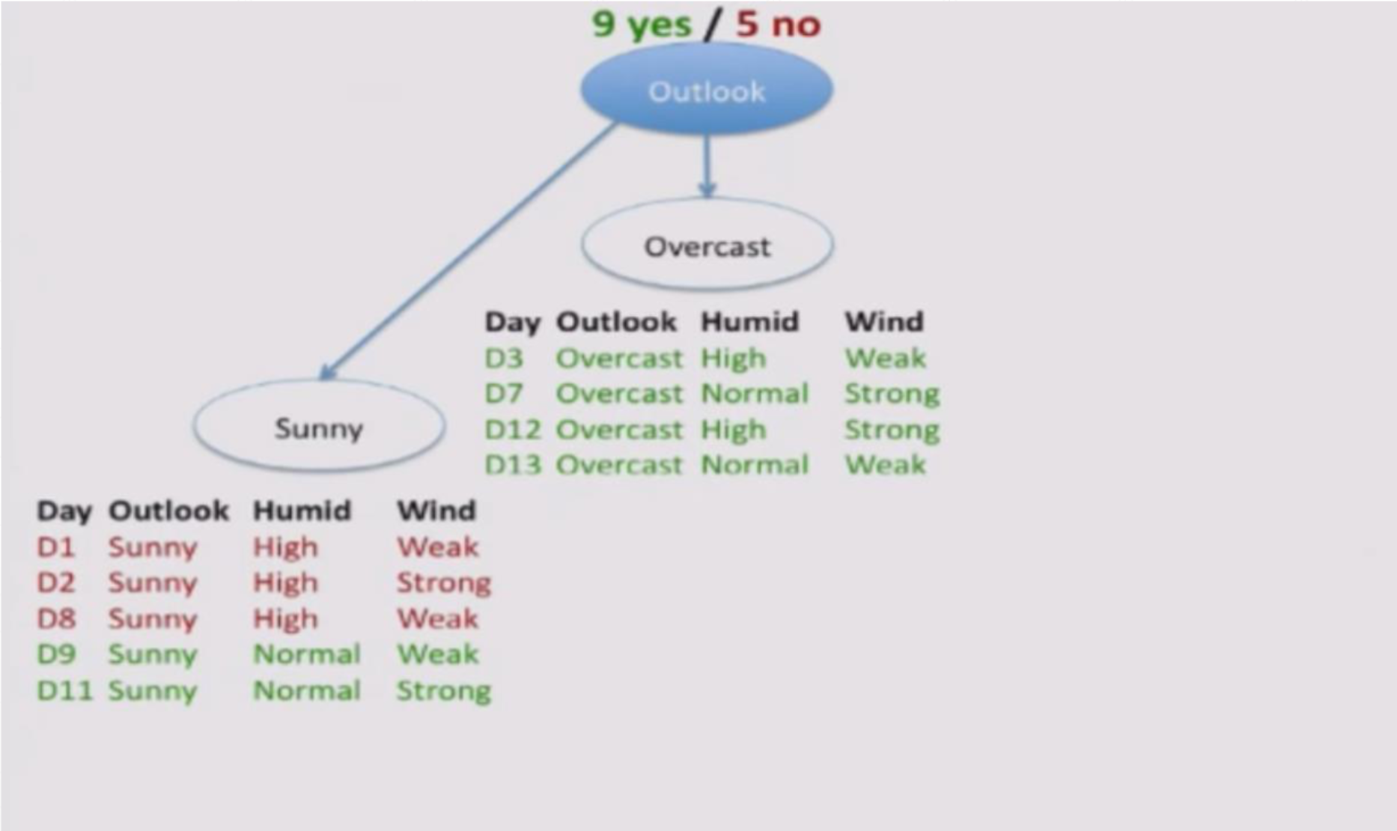

Slide 20
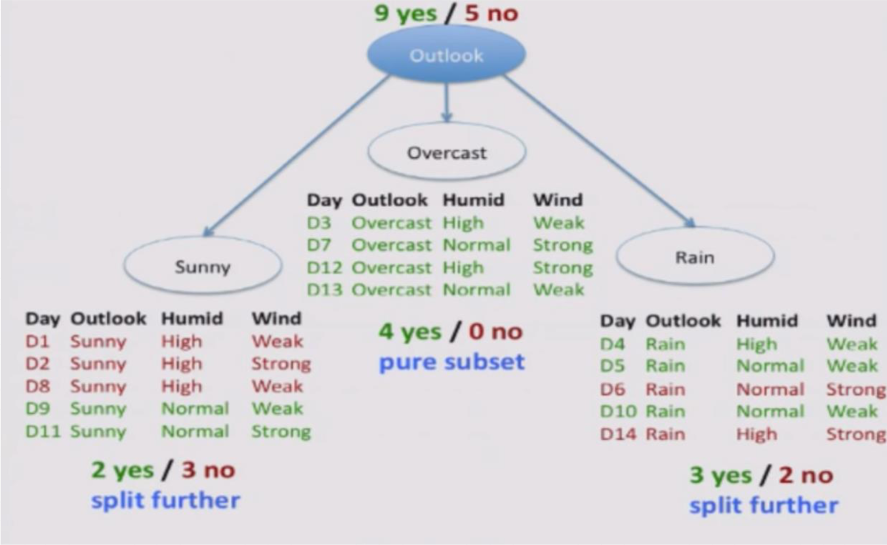

Slide 21
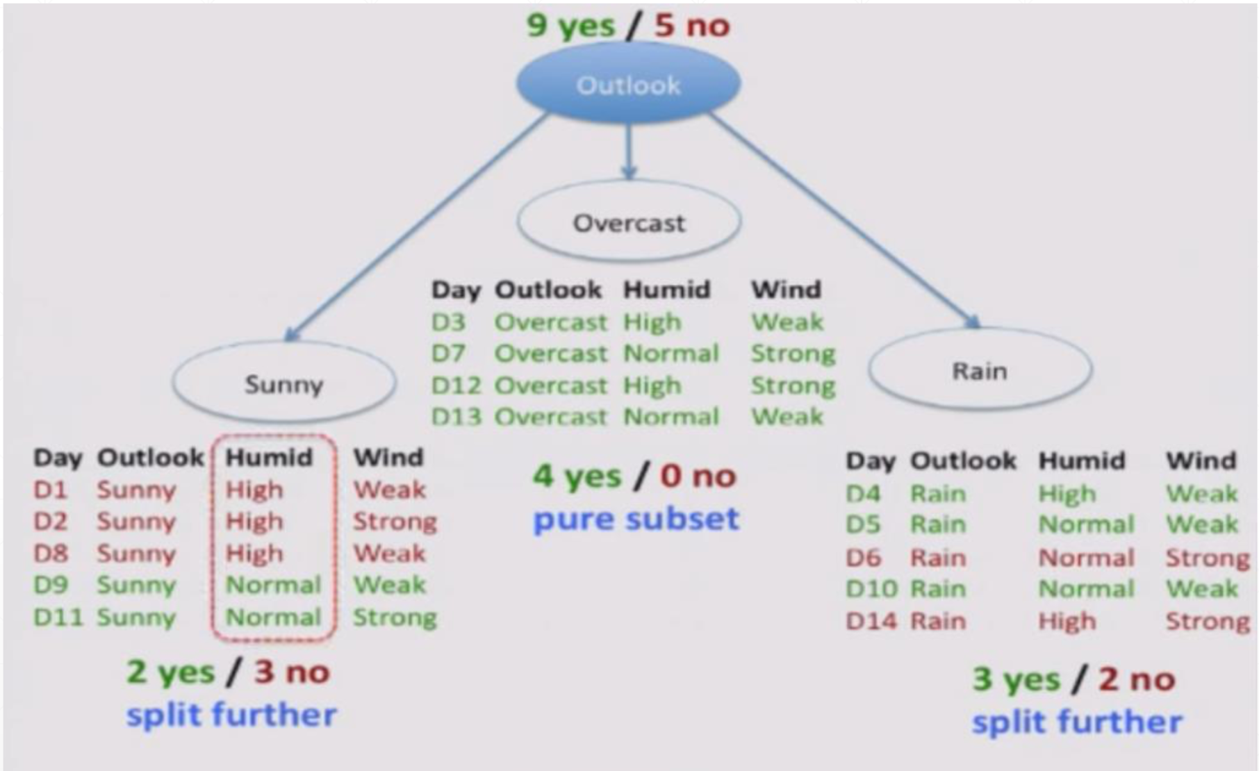

Slide 22
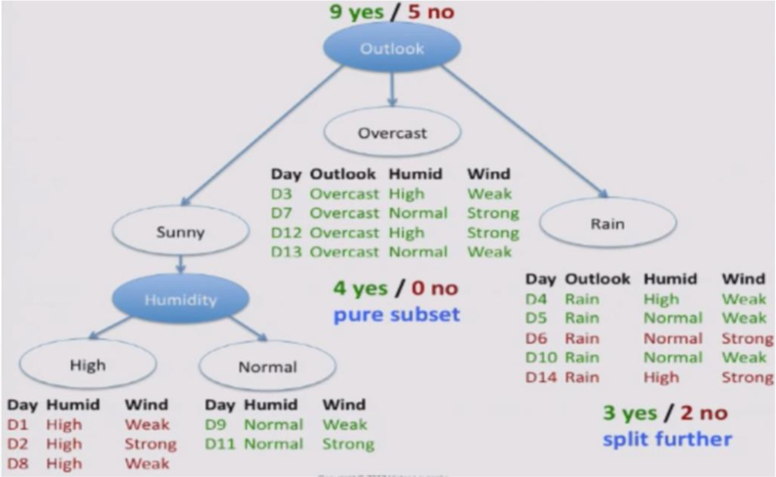

Slide 23
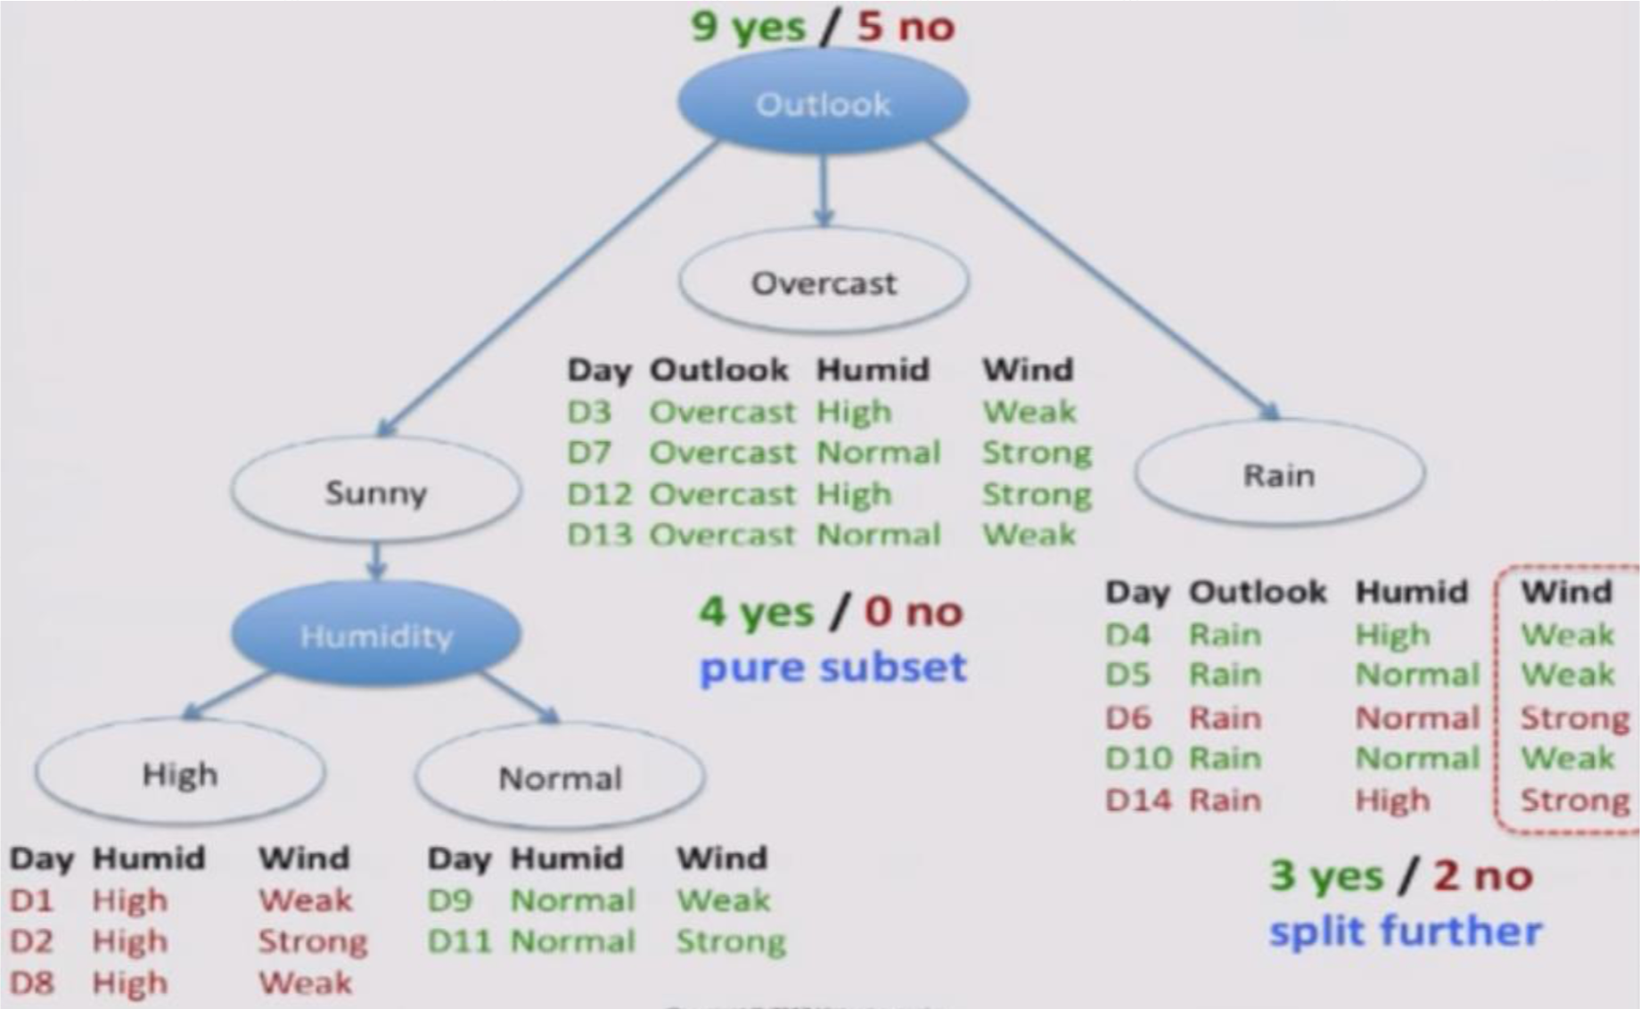

Slide 24
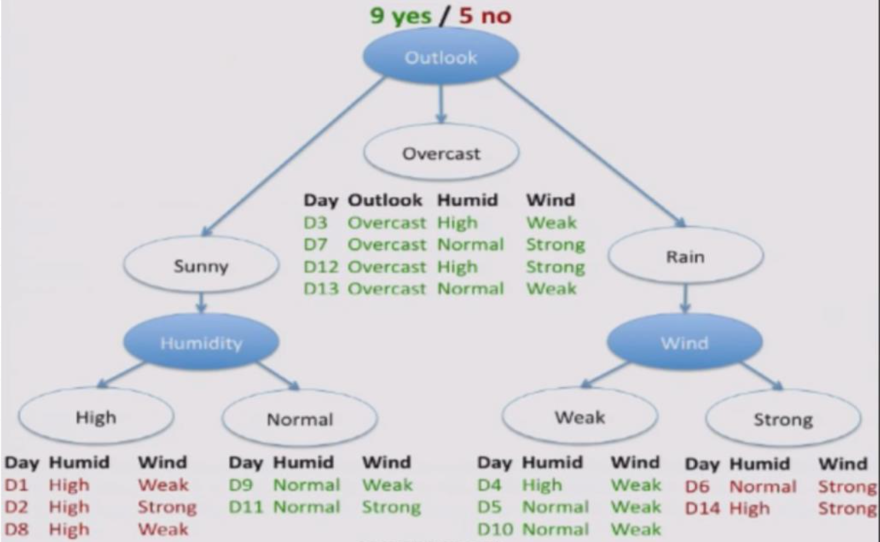

Slide 25
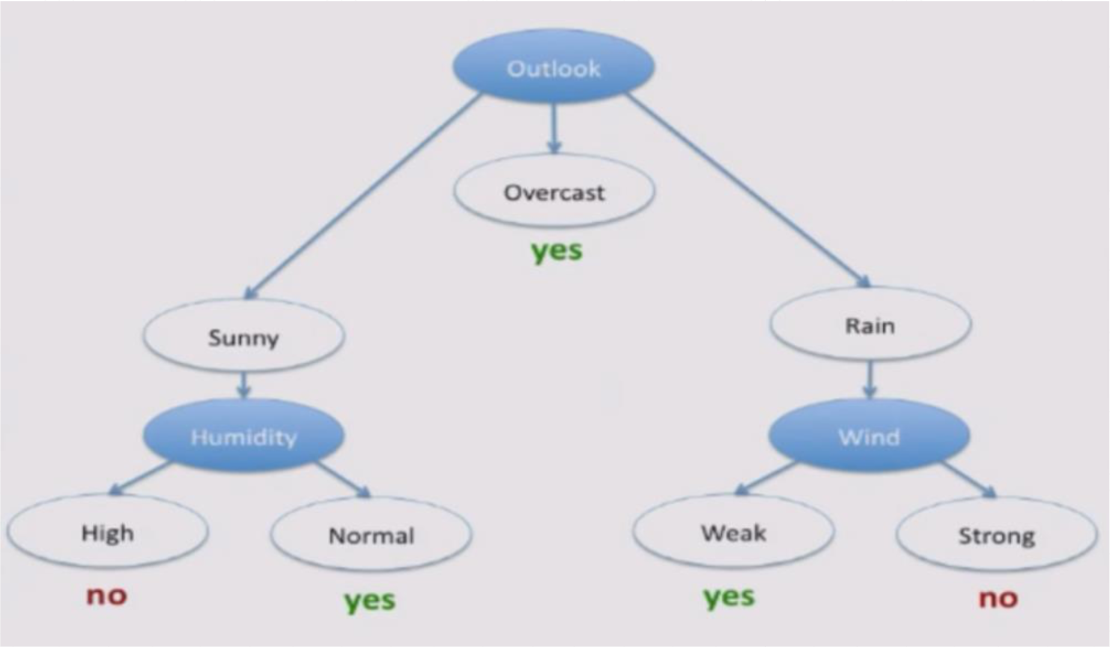

Slide 26
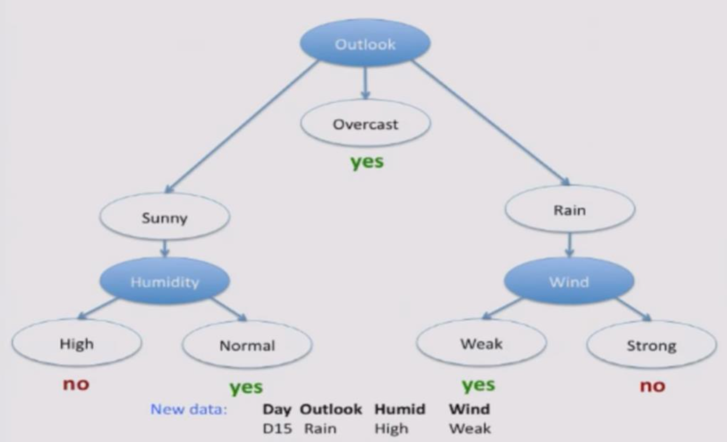

Slide 27
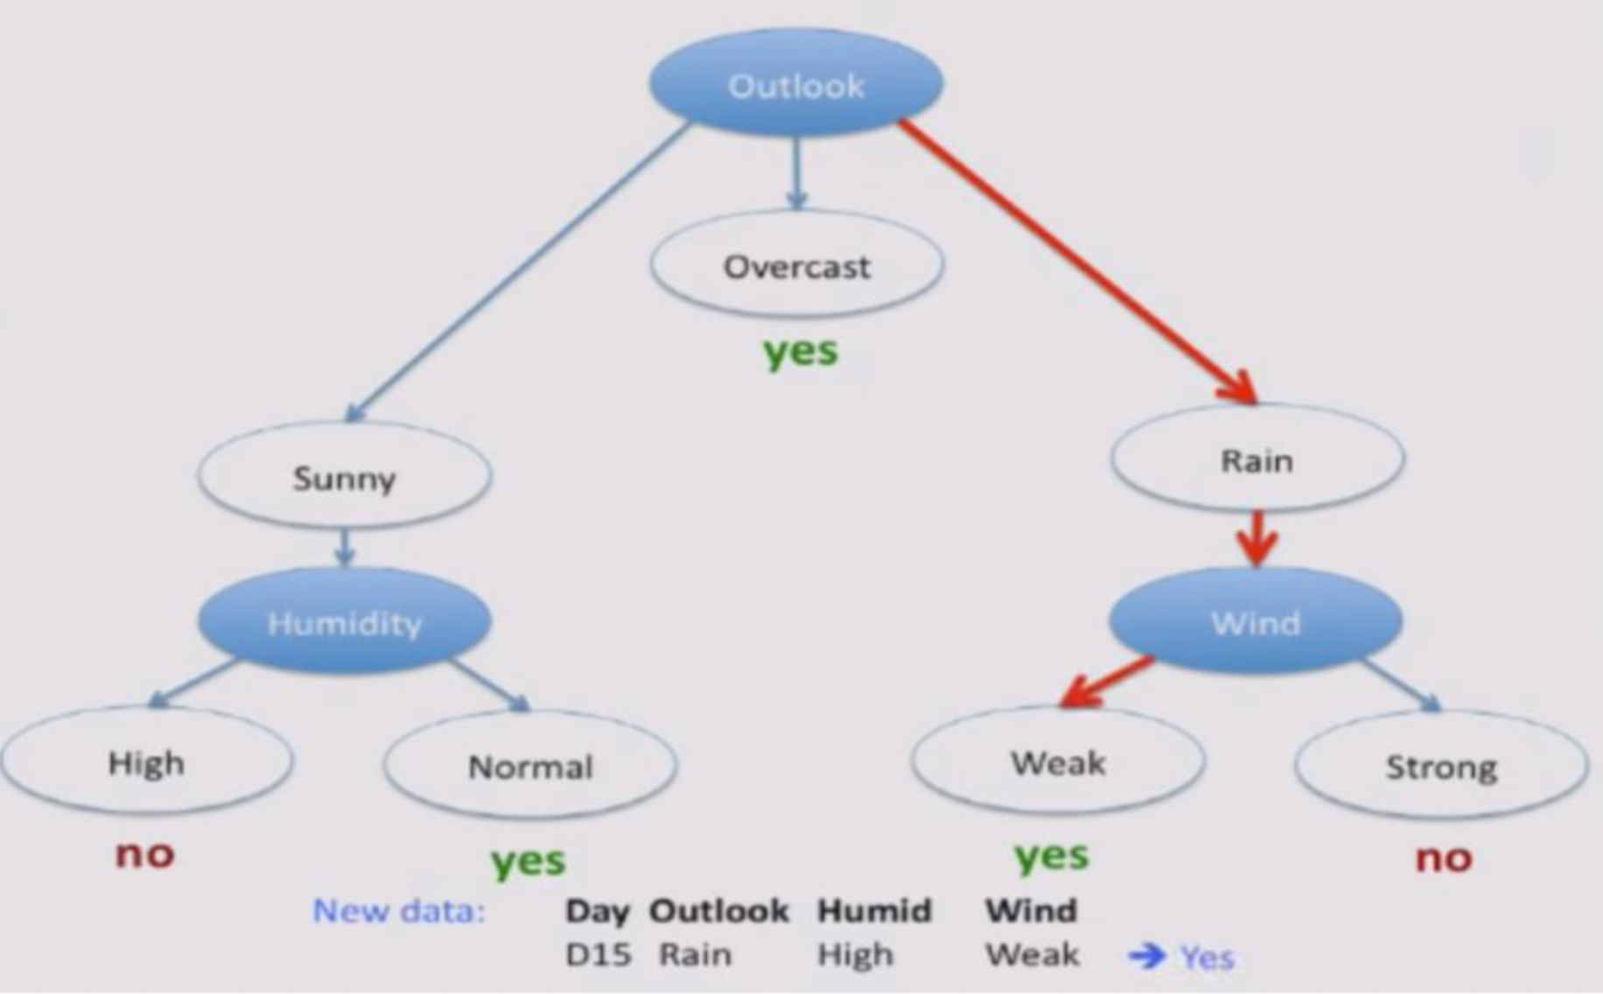

Slide 28
Broadly - What is the algo doing?
Cool. But how does the decision tree know the best value to split at in a given feature to maximize splitting efficiency?
To the codebook!

Slide 29
Problems
Growing the full tree -> MASSIVELY specific to training data
What does that do in terms of bias-variance?
Solutions
Pre-pruning
Post-pruning
Ensemble methods (tomorrow)

Slide 30
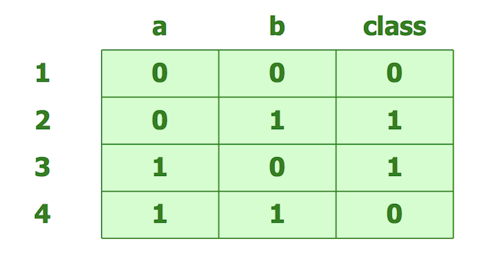
Pre-pruning
Stopping conditions: when to turn a node into a leaf?
Max tree depth
Don’t require purity; specify % mix of classes to reach
Test whether obs in node have statistical relationship to target (frex using chi square test); if not, turn into a leaf
Problem with early stopping --->
But: rare, pre- faster than post-

Slide 31
Post-pruning
“Subtree replacement”
3 ‘1’s
6 ‘0’s
1 ‘1’
5 ‘1’s
1 ‘0’

Slide 32
Post-pruning
“Subtree replacement”
‘1’s
6 ‘0’s
1 ‘1’

Slide 33
Post-pruning
“Subtree raising”
3 ‘1’s
6 ‘0’s
1 ‘1’
5 ‘1’s
1 ‘0’

Slide 34
Post-pruning
“Subtree raising”
3 ‘1’s
1 ‘0’
5 ‘1’s
2 ‘0’s
4 ‘0’s
1 ‘1’

Slide 35
Other uses
Can be used as regressors, not just classifiers
Splitting criterion instead of entropy: minimize variance of values in each possible split
Predict avg value of obs in leaf nodes (regression)
Floor on # of obs in leaf node (ie can’t do regressions on single points)
Can be used to explore data, not just modeling

Slide 36
Pros
Interpretable, not a black box
Handles irrelevant features well
Can handle missing features
FAST

